Slide 1
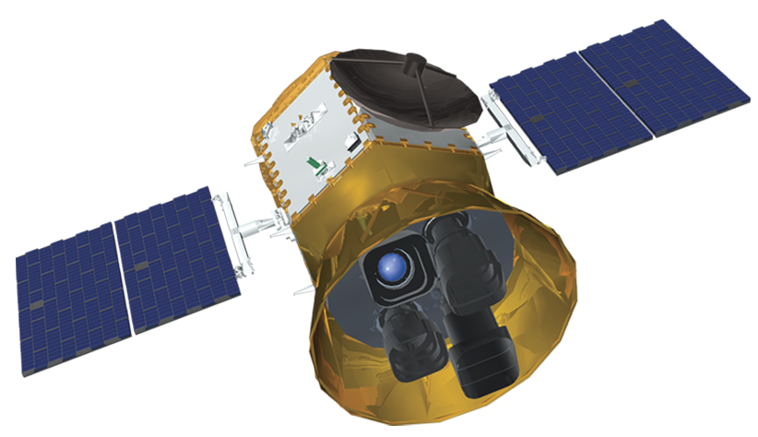

Transiting Exoplanet Survey Satellite
Daryl Swade
Archive Team Meeting
June 16, 2014
<number>

Slide 2
Agenda
Science goals
Mission concept
Organization
MAST
<number>

Slide 3
Science goals
<number>

Slide 4
TESS Science Goals and Drivers
Primary Goal: Discover Transiting Earths and Super- Earths Orbiting Bright, Nearby Stars
  Rocky Planets & Water Worlds
  Habitable Planets
Discover the “Best” ~1000 Small Exoplanets
  “Best” Means “Readily Characterizable”
    Bright Host Stars
    Measurable Mass & Atmospheric Properties
  Present: Only 2 small transiting exoplanets orbiting bright hosts are known
Large Area Surveys of Bright Stars
  F, G, K dwarfs: +4 to +12 magnitude
  M dwarfs known within ~60 parsecs
  >200,000 target stars in two years
4

Slide 5
TESS Science Objectives
OBJECTIVE 1: Locate a diverse sample of transiting small exoplanets orbiting the brightest stars in the solar neighborhood.
OBJECTIVE 2: Locate a sample of transiting small exoplanets orbiting bright stars situated near the ecliptic poles, locations that are optimal for JWST follow-up.
OBJECTIVE 3: Establish the masses of a sample of TESS-located small transiting planets by means of precise radial velocity measurements.
4

Slide 6
TESS and Kepler Address Different Questions
TESS: Where are the nearest transiting rocky planets?
Kepler: How common are true Earth Analogs?
Solid angle coverage
  Ω_{TESS} ≃ 400 Ω_{Kepler}
  Number of accessible bright stars increased by same factor
Catalog star distances
  TESS: ~10² light-yr
  Kepler: ~10³ light-yr
  1/R² dependence means TESS stars are ~100x brighter than Kepler on average
4

Slide 7
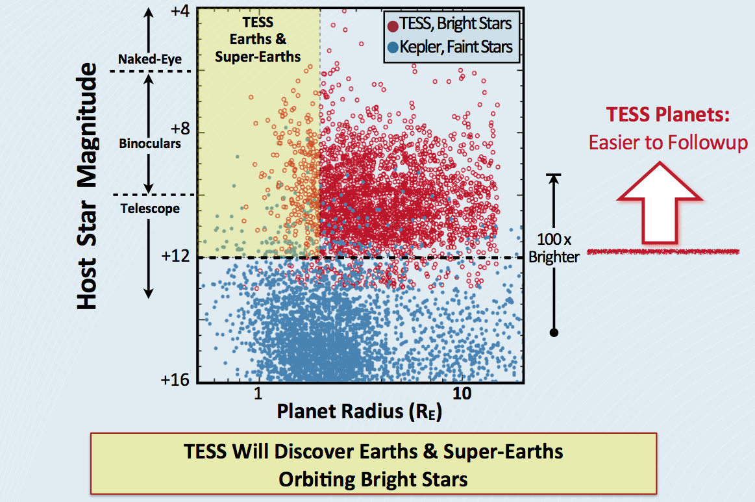
Comparison of Host Star Brightness
4

Slide 8
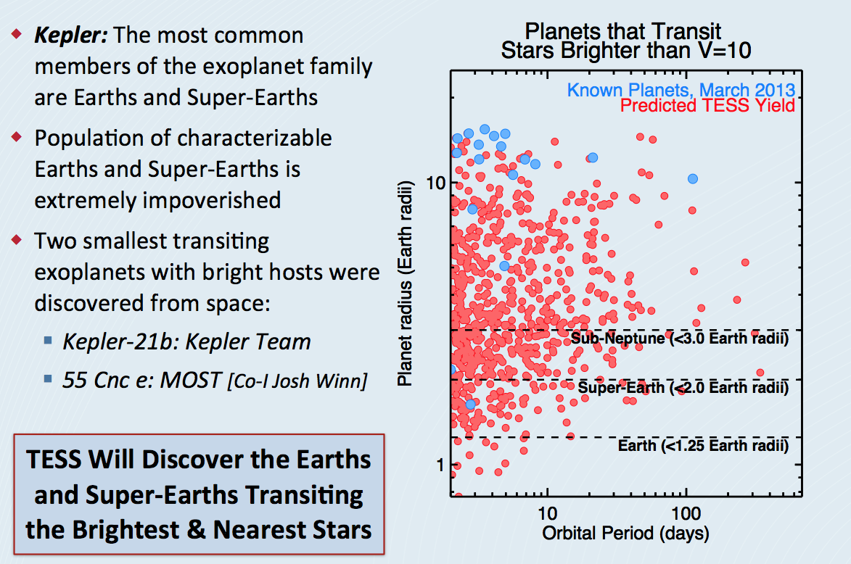
Small Planets and Bright Stars
4

Slide 9
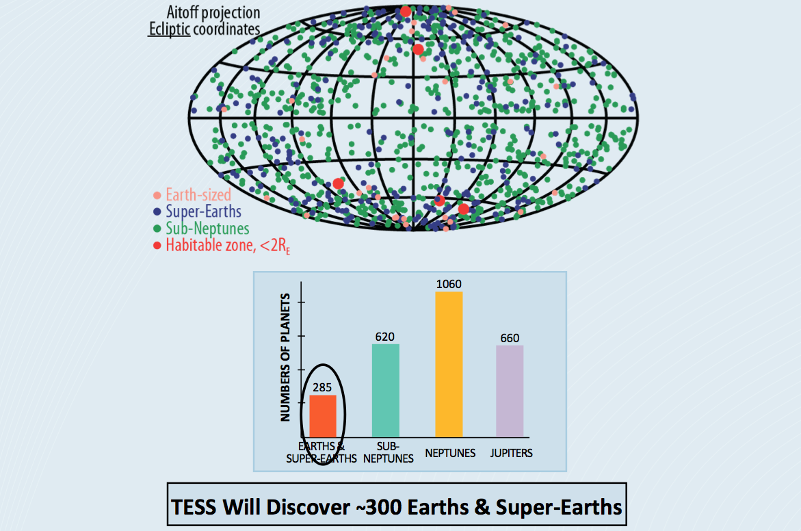
Predicted Science Yield from TESS Mission
4

Slide 10
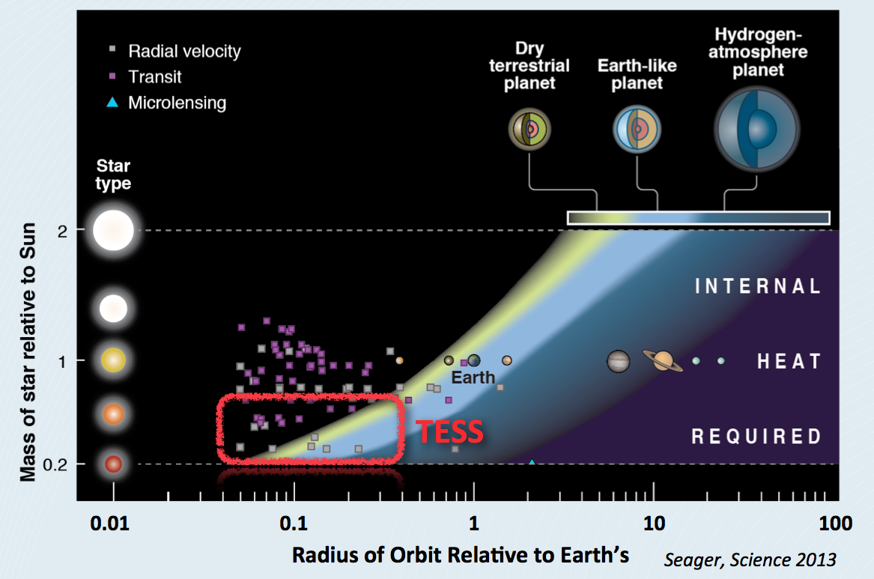
TESS and the Habitable Zone
4

Slide 11
Mission concept
4

Slide 12
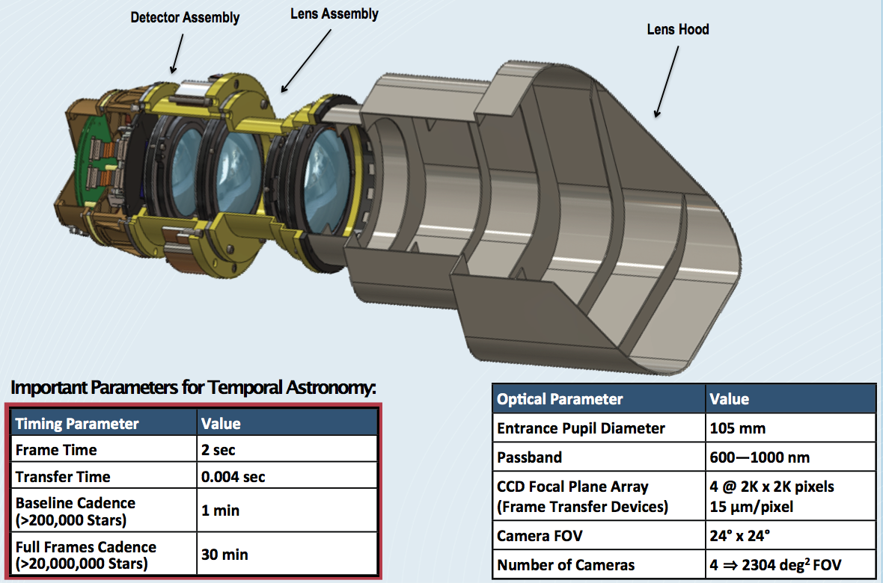
TESS Wide FOV CCD Camera
4

Slide 13
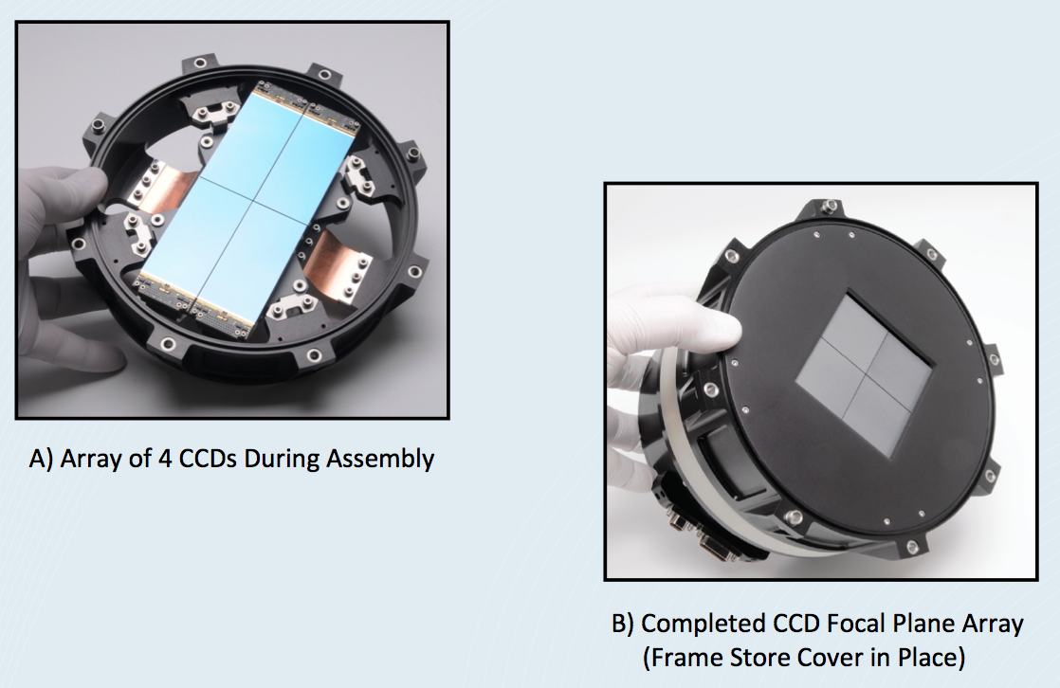
TESS Prototype Focal Plane Assembly
4

Slide 14
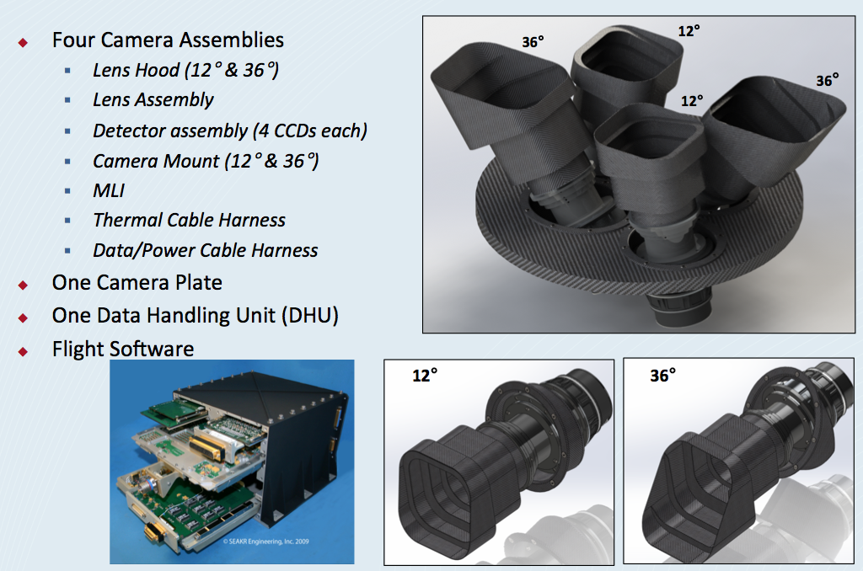
Instrument Overview
4

Slide 15
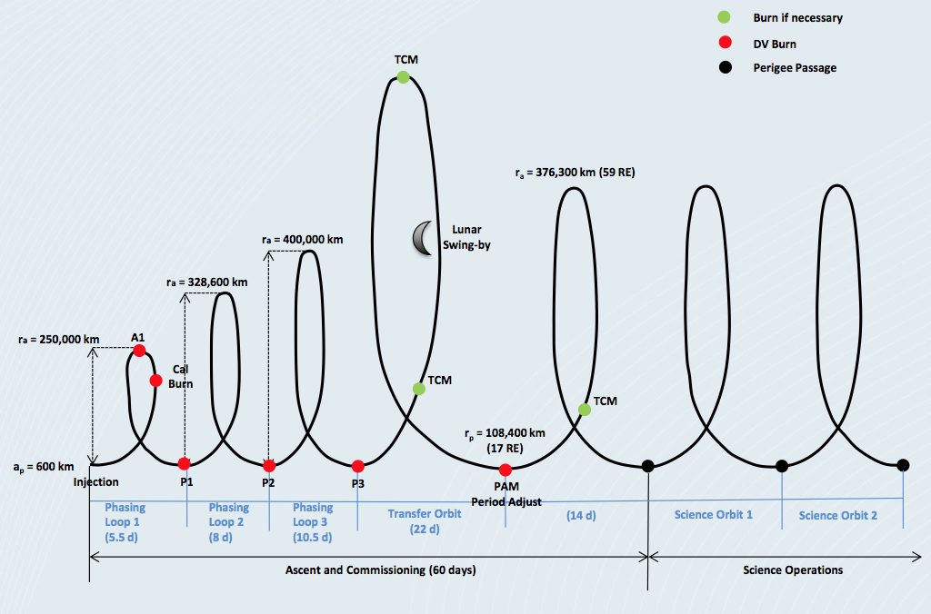
Launch to Science Orbit Timeline
4

Slide 16
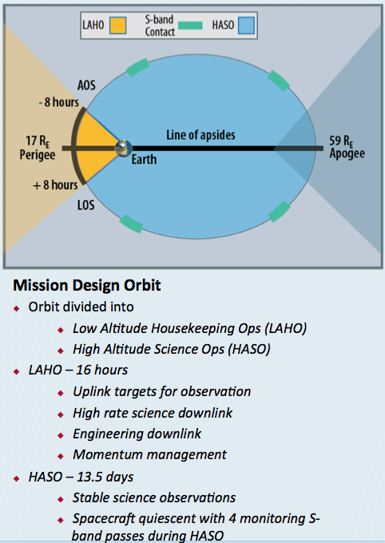
Operations Concept: Orbit
4

Slide 17
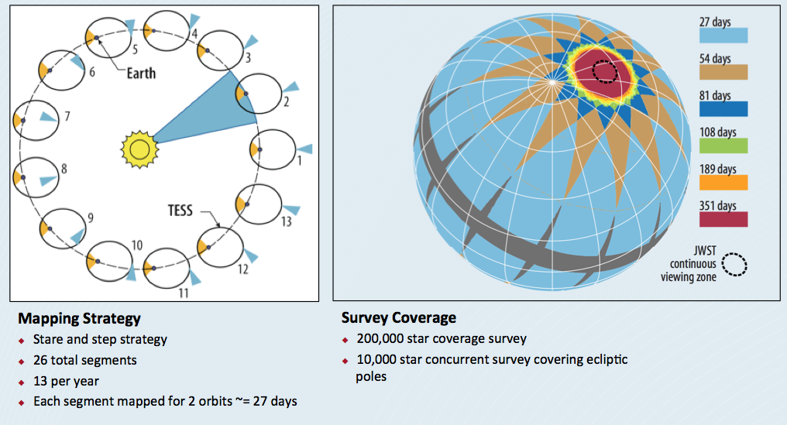
Operations Concept: Survey
4

Slide 18
organization
4

Slide 19
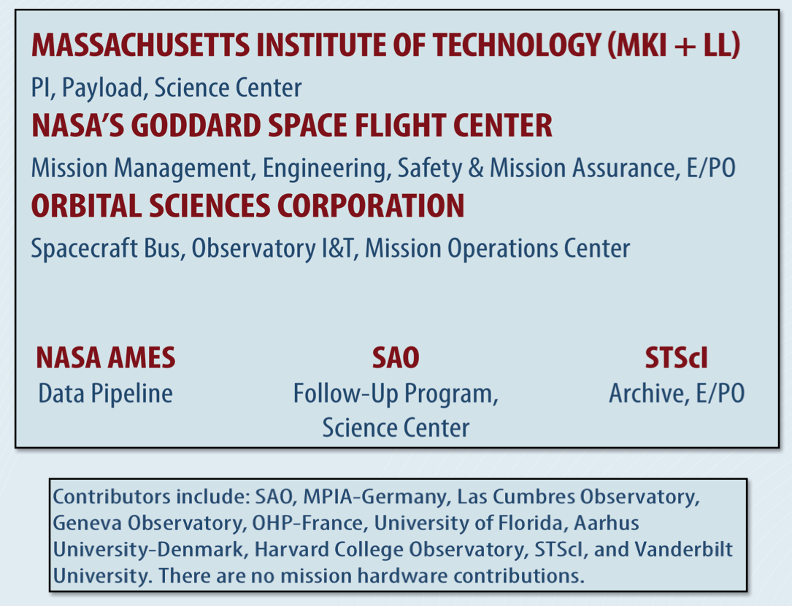
TESS Partnerships
4

Slide 20
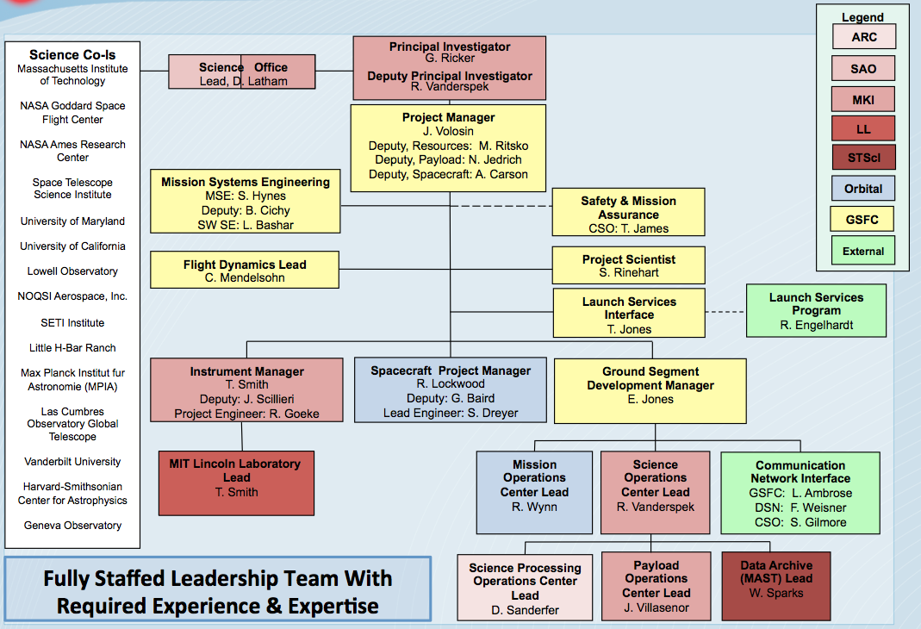
TESS Project Organization
4

Slide 21
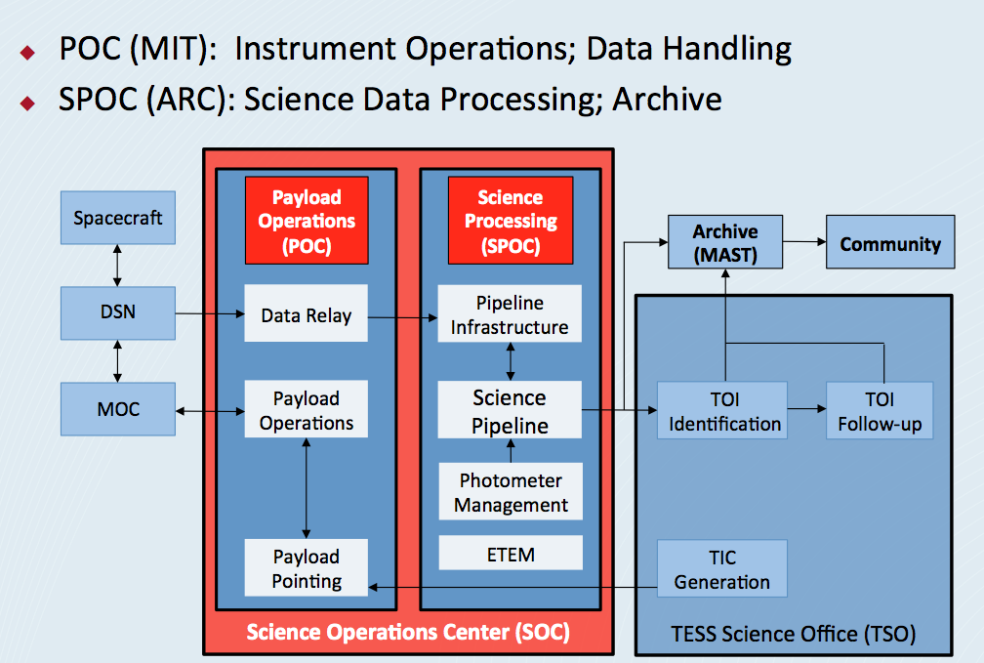
SOC
4

Slide 22
MAST
4

Slide 23
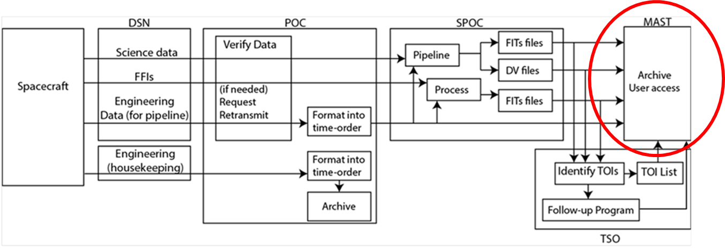
TESS Ground Segment Architecture
<number>

Slide 24
TESS Raw Data
Data types
  Kepler:
    long cadence target – 150,000 targets, 32 pixels/target, 30 minutes cadence
    short cadence target – 300 targets, 85 pixels/target, 1 minute cadence
    full frame image – one per month
  TESS:
    Target – 25000 targets/month, 100 pixels/target, 1 minute cadence
    Full Frame Image – 30 minute cadence
TESS raw data volume: 6600 GB/ year
  Target data: 3500 GB/year
  Full Frame Image data: 3100 GB/year
Kepler raw data volume: 380 GB/year
  Long cadence: 293 GB/year
  Short cadence: 84 GB/year
  FFI: 2.3 GB/year
<number>

Slide 25
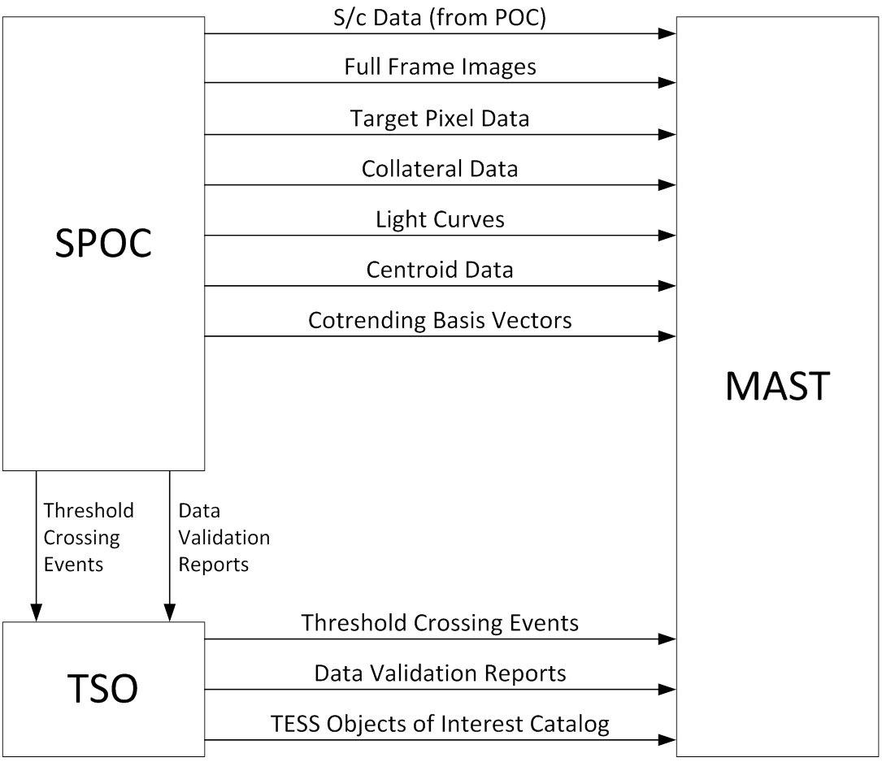
MAST Interfaces
<number>

Slide 26
TESS Archive Data Products from SPOC
Full Frame Image
Target Pixel Files
  All pixels for a single target
  Raw and calibrated values
Light Curves
  Output of photometric analysis and cotrending
Collateral Pixel Files
  Calibration data collected on-board
Ground calibration data
  Cotrending Basis Vectors
    Systematic trends present in the ensemble of flux data for each CCD
  Pixel Response Function
    Point spread function and pointing and electronic systematics
  Flat Field
    Pixel response non-uniformity map
<number>

Slide 27
TESS Data Products from TSO
TESS Input Catalog (TIC)
Threshold Crossing Events (TCE) summary report
  Identified from light curves
Data Validation (DV) results
  Characterize and validate TCEs
TESS Objects of Interest (TOI) Catalog
Follow-up observations
<number>

Slide 28
Archive Operations
TESS monthly processing (Kepler quarterly)
  Transferred from SPOC via hard drive
TESS archive data volume – 50 TB/year (to be refined)
  Total Kepler archive data volume – 19 TB (Q0-Q17)
    Does not consider reprocessed data
No proprietary period on data
  Availability depends primarily on SPOC processing time (<1 month)
Primary TESS web site hosted by MIT
  Links to MAST web site
<number>

Slide 29
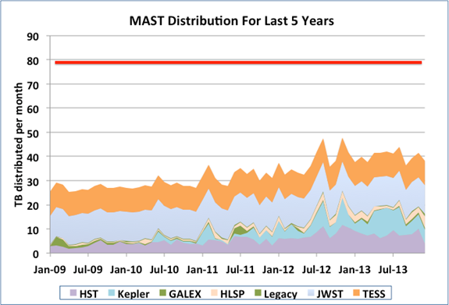
Archive Distribution Performance
<number>

Slide 30
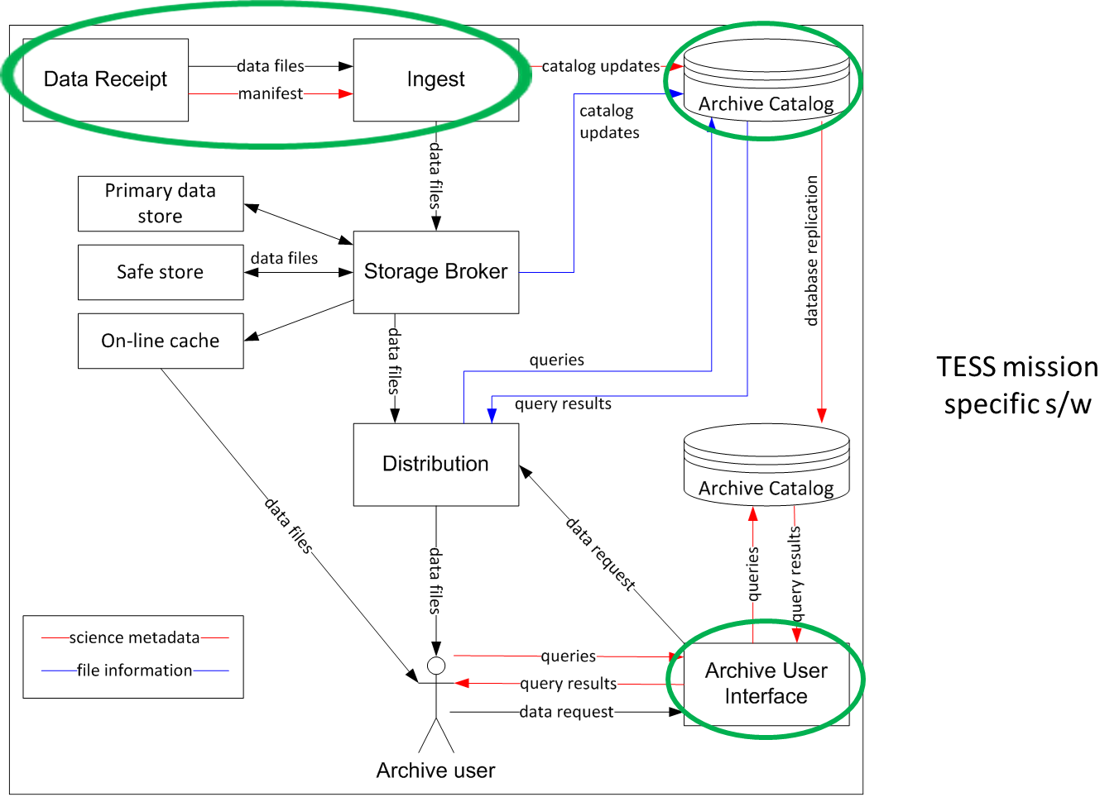

Archive System Enhancements for TESS
<number>

Slide 31
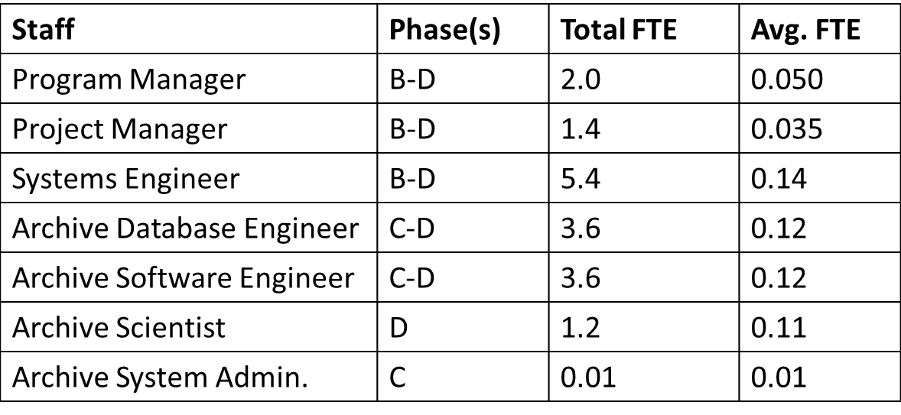
Archive Development Effort
Phase B: April 1, 2014 – October 1, 2014
Phase C: October 2, 2014 – November 29, 2016
Phase D: November 30, 2016 – July 17, 2017
<number>

Slide 32
MAST Deliverables
Deliverable | Responsibility | Phase | Date of Delivery
TESS Archive Operations Concept | Systems Engineer | B | PDR
TESS-Archive ICD SPOC-Archive TSO-Archive | Systems Engineer | B/C | PDR/CDR
Archive Catalog Design Specification | Systems Engineer | B/C | PDR/CDR
Archive Architecture | Systems Engineer | B/C | PDR/CDR
Archive Software Design | Systems Engineer | C | CDR
TESS Archive User Interface | Software Engineers | C/D | GS Test
Archive Test Procedures | Systems Engineer | D | GS Test
Archive Operations Procedures | Archive Operator | D | Launch
TESS Archive User’s Guide | Archive Scientist | E | Launch
<number>

Slide 33
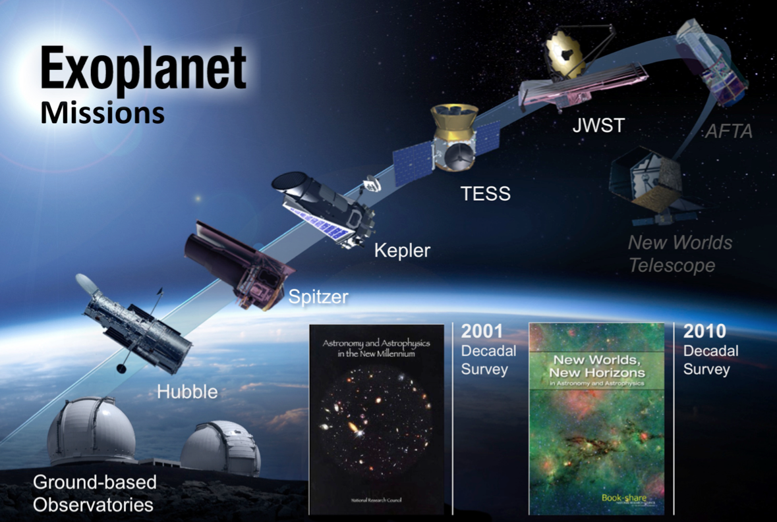
TESS: A Bridge to the Future
<number>

