Slide 1
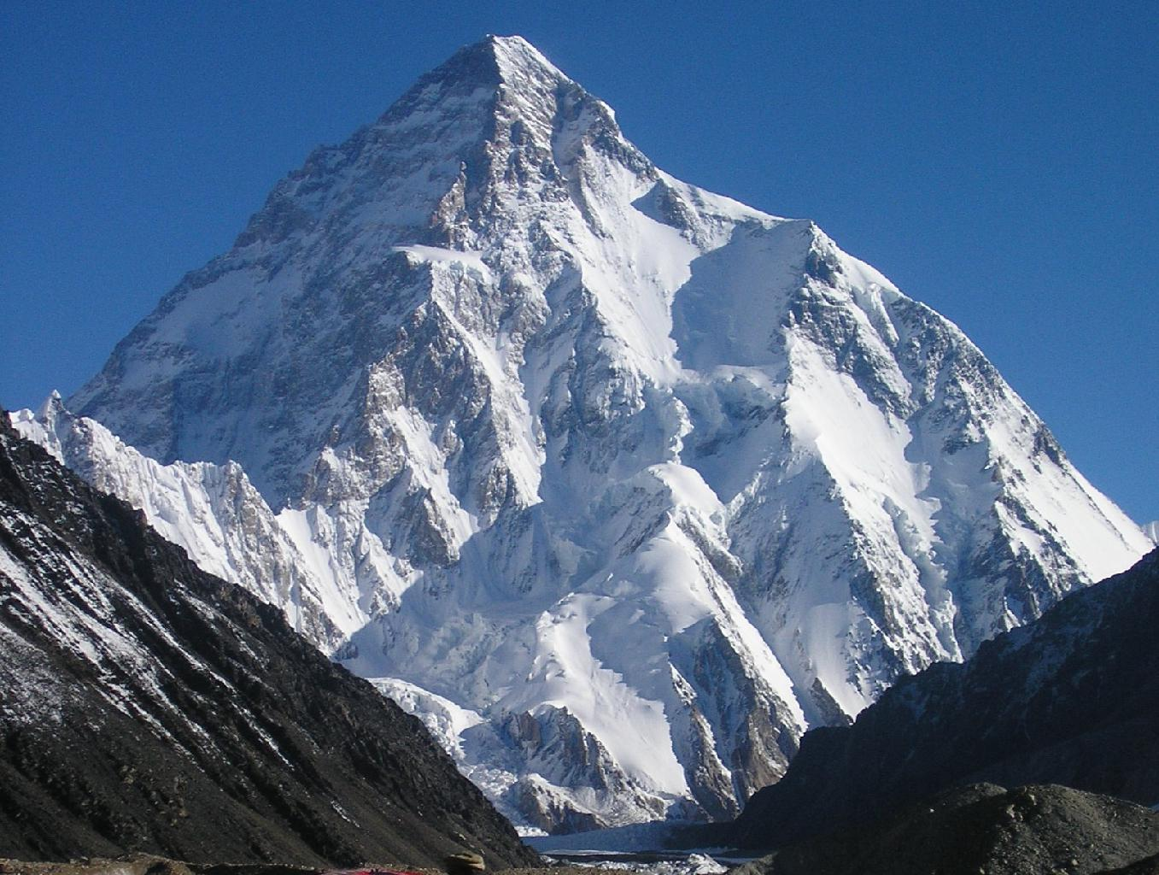
K2
Kepler’s Second Mission
Steve B. Howell
NASA Ames Research Center
K2 - a 2-wheel Kepler mission; The second highest peak in the world, a worthy ascent
<number>

Slide 2
K2 Mission History
Kepler’s 2nd reaction wheel failed in May 2014
~1 year ago proto-K2 started: white papers out, on-orbit tests conducted
Submitted NASA senior review proposal – Jan 2014
Senior review approved K2 mission for 2-4 years
K2 mission performed first test campaign - March-May 2014
K2 mission officially started 1 June 2014
2

Slide 3
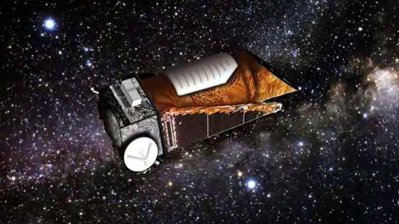
K2 Mission Assets
Telescope already in space
Heliocentric orbit
Large field of view – many targets
Long, uninterrupted time on targets
High precision photometry
Faint sources due to 1-m aperture
Experienced personnel
3

Slide 4
K2 –
How it works
Spacecraft pointing limited by power and
sun angle constraints
Solar pressure
50 micronewtons/m^2
3

Slide 5
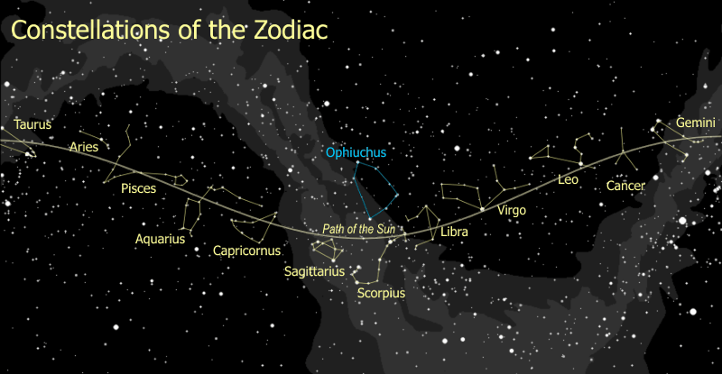
K2 mission concept
Ecliptic plane pointings allow the K2 mission to balance high-impact science, technical feasibility, and cost
Observe ~4 different fields per year (~80-day campaigns)
New science enabled by various galactic locations
Observe 10,000-20,000 targets per field
Great photometric precision
No exclusive use period
Data to public archive
5

Slide 6
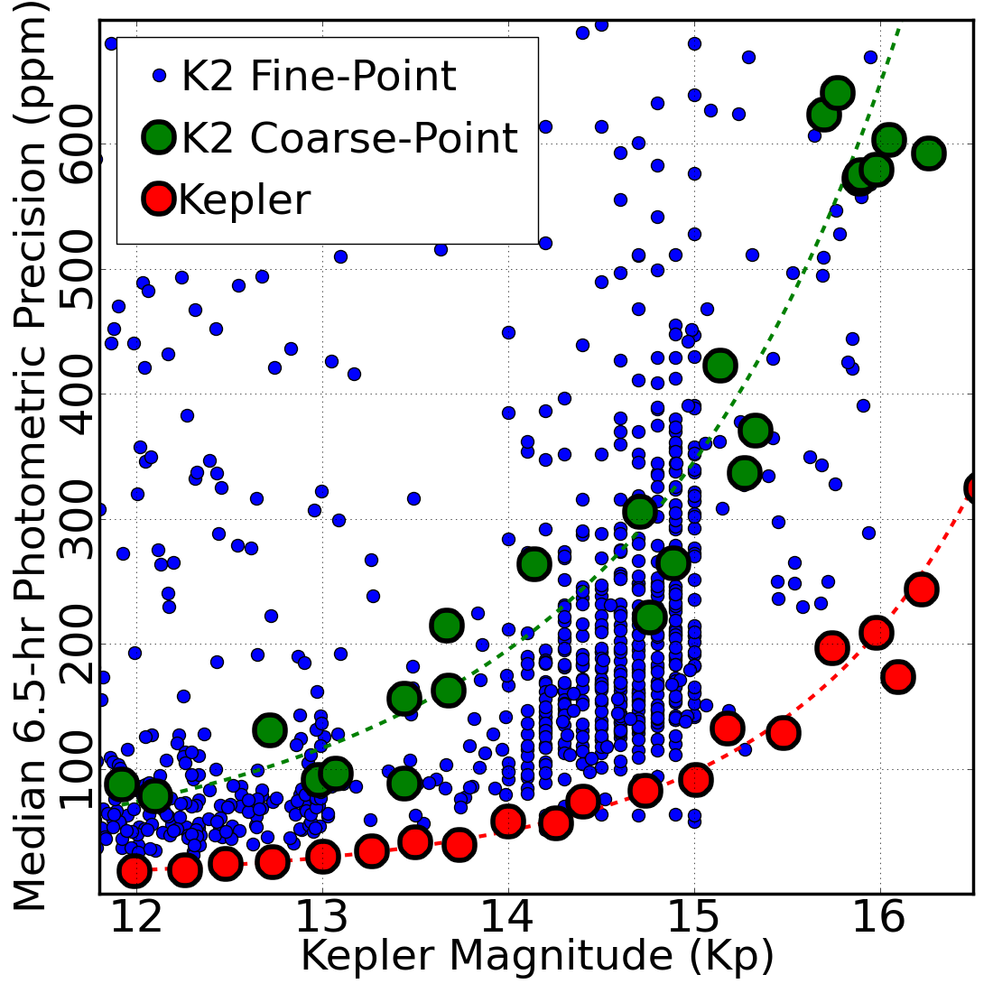
Photometric Precision in Fine Point
Fine-point operations provide photometric precision to within a factor of 2 of the Kepler mission
The mode of the noise distribution for K2 fine-point data is:
Magnitude (Kp) | 6.5-hr Precision (ppm)
12.0 | 60
14.5 | 160
K2 Senior Review Orals – 1 April 2014
5
OVERVIEW
PROGRESS & SCIENCE IMPLICATIONS
STATUS & COMMUNITY INVOLVEMENT
SPACECRAFT HEALTH
CONCLUSION
Notes:
<number>

Slide 7
Current State of K2 Photometry
Module 3 died early on , Module 7 died Jan-Feb 2014
K2 will deliver calibrated pixel files first and light curves sometime later in this fiscal year.
A number of groups are already working to make K2 light curves: K2 project, J. Johnson’s group, S. Aigrain’s group, NexSci (Jessie C.) , …..
Telescope pointing will further improve in campaign 3, leading to better photometry
Current state: ~150 ppm 30-min data, ~45 ppm 6.5 hr avg. (12 magnitude star)

Slide 8
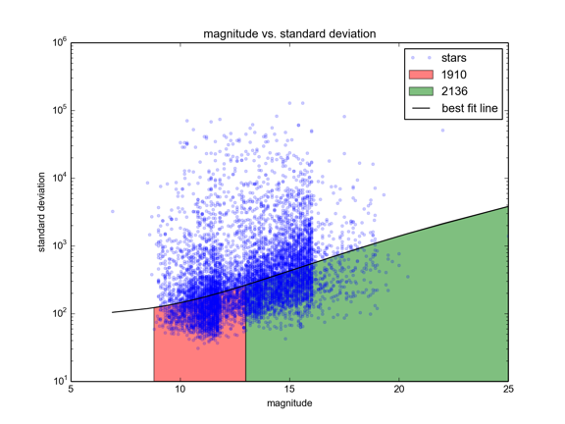
K2 C0 “CDPP-like” Results

Slide 9
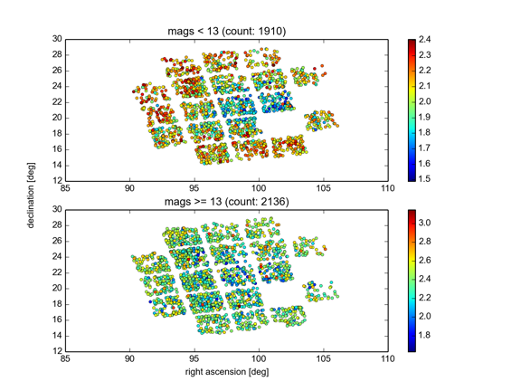
Photometric Location
Log “CDPP”

Slide 10
K2 Campaign Fields
K2 ecliptic pointings in the first two years cover northern and southern sky,
high and low galactic latitude, 10X greater sky coverage than Kepler mission.
K2 fields highlight star clusters, star forming regions, extragalactic fields,
including science not available with Kepler.
7
Steve Howell

Slide 11
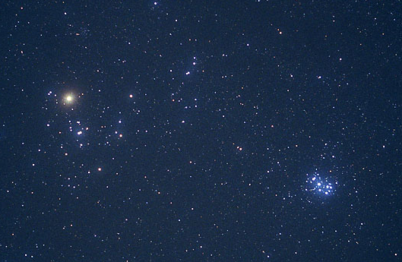

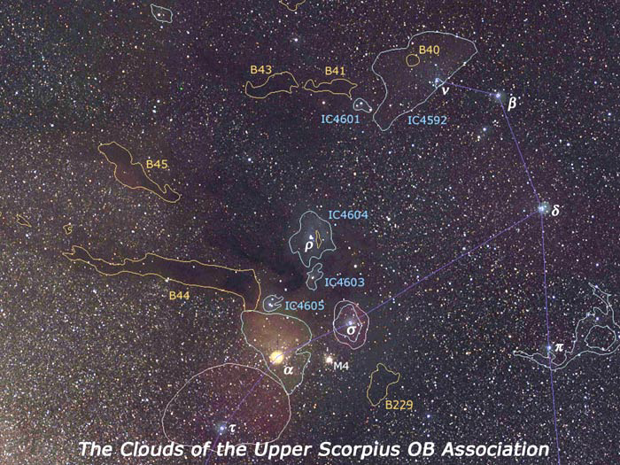

Surveying the Ecliptic
Pleiades & Hyades
Upper Sco
K2 Senior Review Orals – 1 April 2014
<number>
OVERVIEW
PROGRESS & SCIENCE IMPLICATIONS
STATUS & COMMUNITY INVOLVEMENT
SPACECRAFT HEALTH
CONCLUSION
Notes:
Wendy, here we need better fields and less focal plane. The angles should be different for the fields of view.
<number>

Slide 12
K2 Campaign Fields
0 2014 Apr 30 06:33:11.14 +21:35:16.4
1 2014 Jul 22 11:35:45.51 +01:25:02.3
2 2014 Oct 14 16:24:30.34 -22:26:50.3
3 2015 Jan 05 22:26:39.68 -11:05:48.0
4 2015 Mar 29 03:56:18.22 +18:39:38.1
5 2015 Jun 20 08:40:37.84 +16:49:46.6
6 2015 Sep 11 14:01:11.20 -13:16:02.8
7 2015 Dec 03 19:34:16.22 -22:38:23.4
8 2016 Feb 24 01:04:43.18 +05:11:52.2
9 2016 May 17 18:23:35.72 -24:12:12.8 +Velocity Vector
http://keplerscience.arc.nasa.gov/K2/MissionConcept.shtml#fields

Slide 13
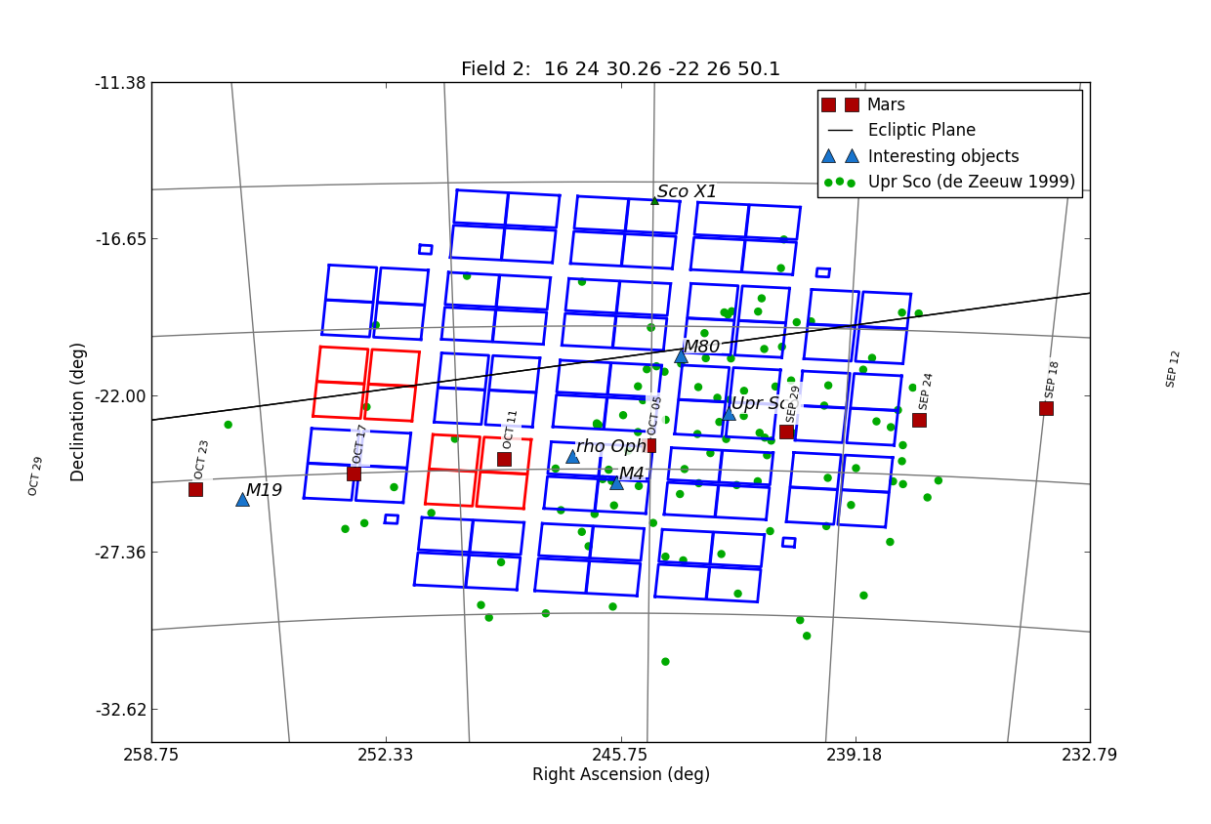

Slide 14
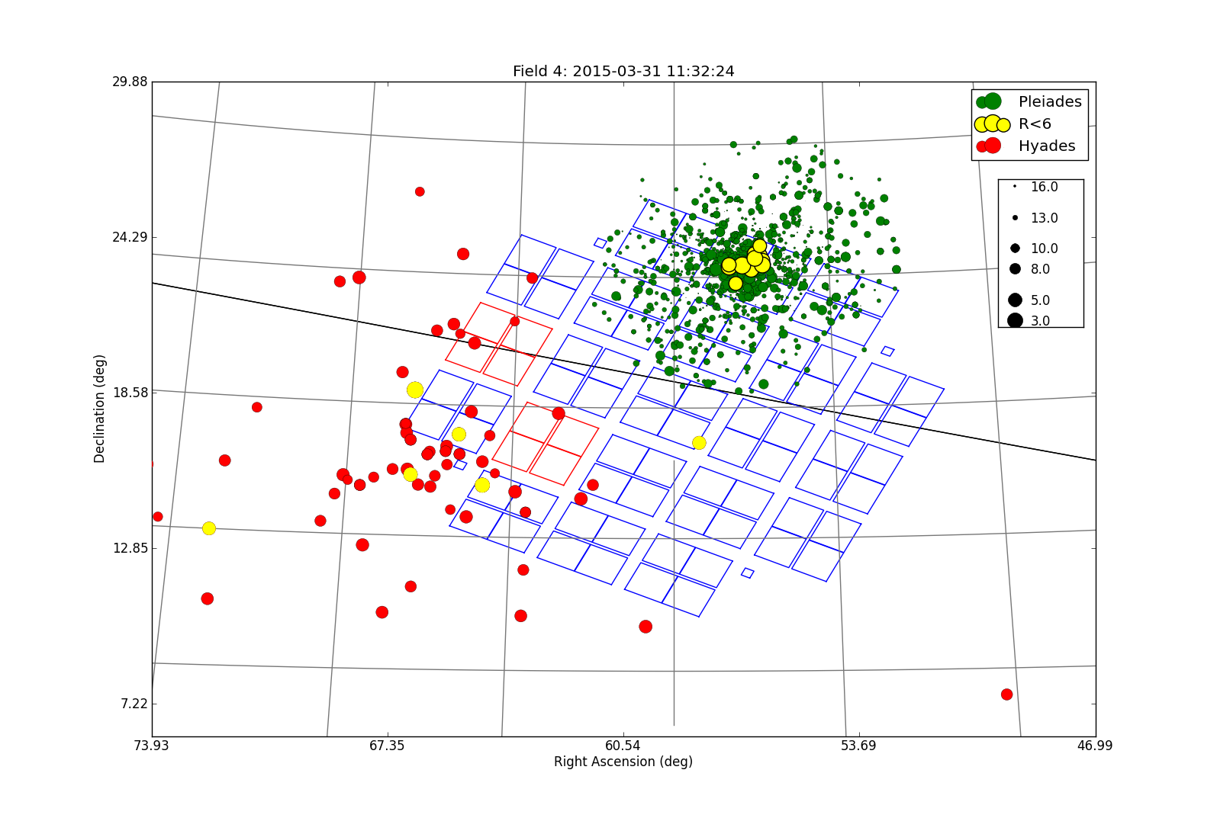

Slide 15
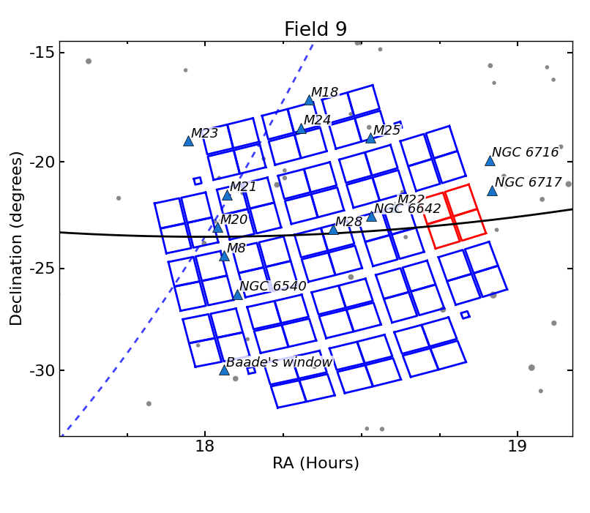
Special
microlens
campaign

Slide 16
K2 Key Science Cases
Transiting Exoplanets – Star Clusters – Star Forming regions
  Exoplanets orbiting low-mass stars
    ~4000 M stars/field; 100’s small planets, dozens in HZ
  Exoplanets orbiting bright stars (R<12)
    Detect ~50 short period, rocky planets per year
    Refine ice to rock boundary
    Early targets for TESS, CHEOPS, JWST
  Exoplanets orbiting young stars & pre-MS stars
    Detection and characterization statistics for this previously unobserved population
<number>

Slide 17
Exoplanets: Bright Stars
K2 transit detection will discover about 50 rocky planets per year.
<number>

Slide 18
Exoplanets: M stars
K2 will find large and small exoplanets and detect rocky
planets within the habitable zone of M stars.
<number>

Slide 19
WASP 28b – Model Equals Reality
Injected transit model confirmed by real observation
K2 light curve – injected Jupiter
K2 light curve of WASP 28b
Time (days)
K2 Senior Review Orals – 1 April 2014
53
OVERVIEW
PROGRESS & SCIENCE IMPLICATIONS
STATUS & COMMUNITY INVOLVEMENT
SPACECRAFT HEALTH
CONCLUSION
Notes:
<number>

Slide 20
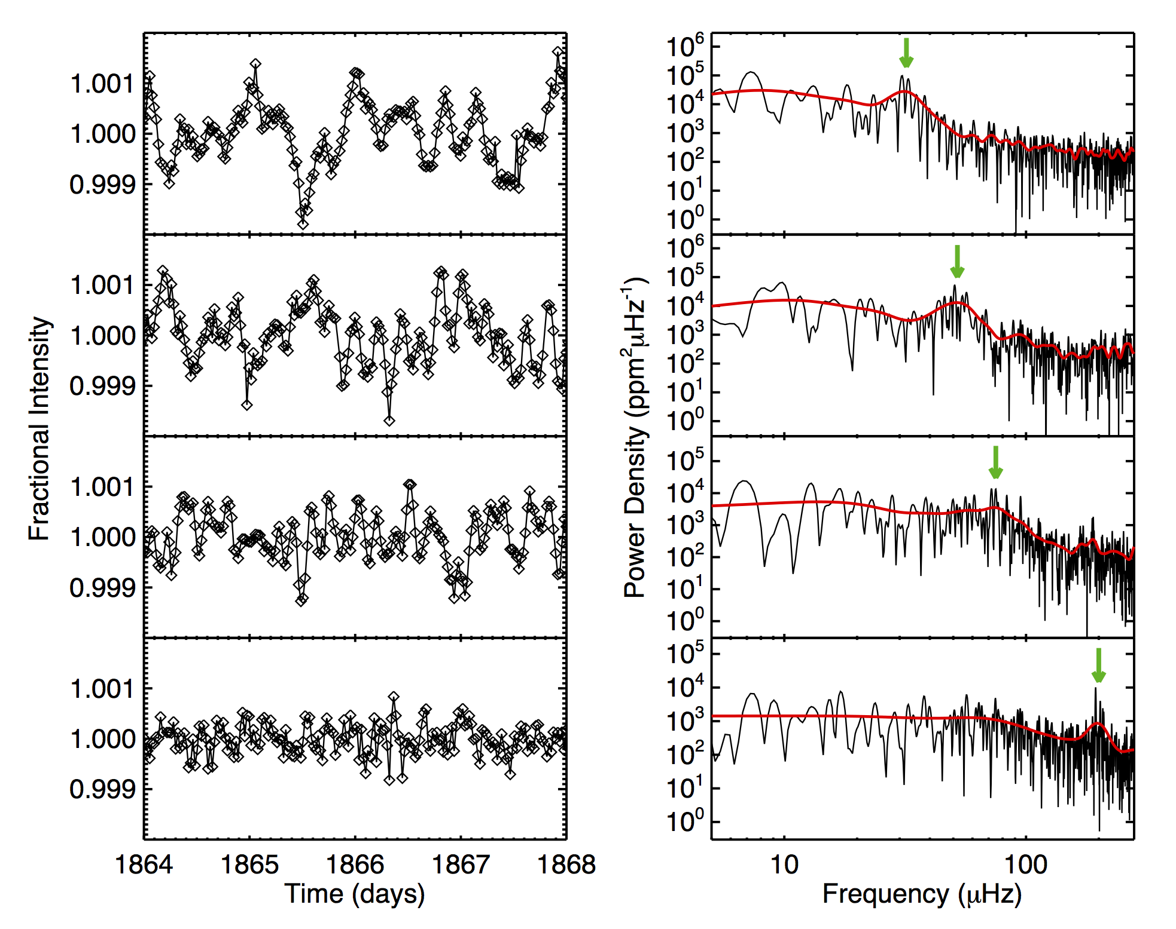
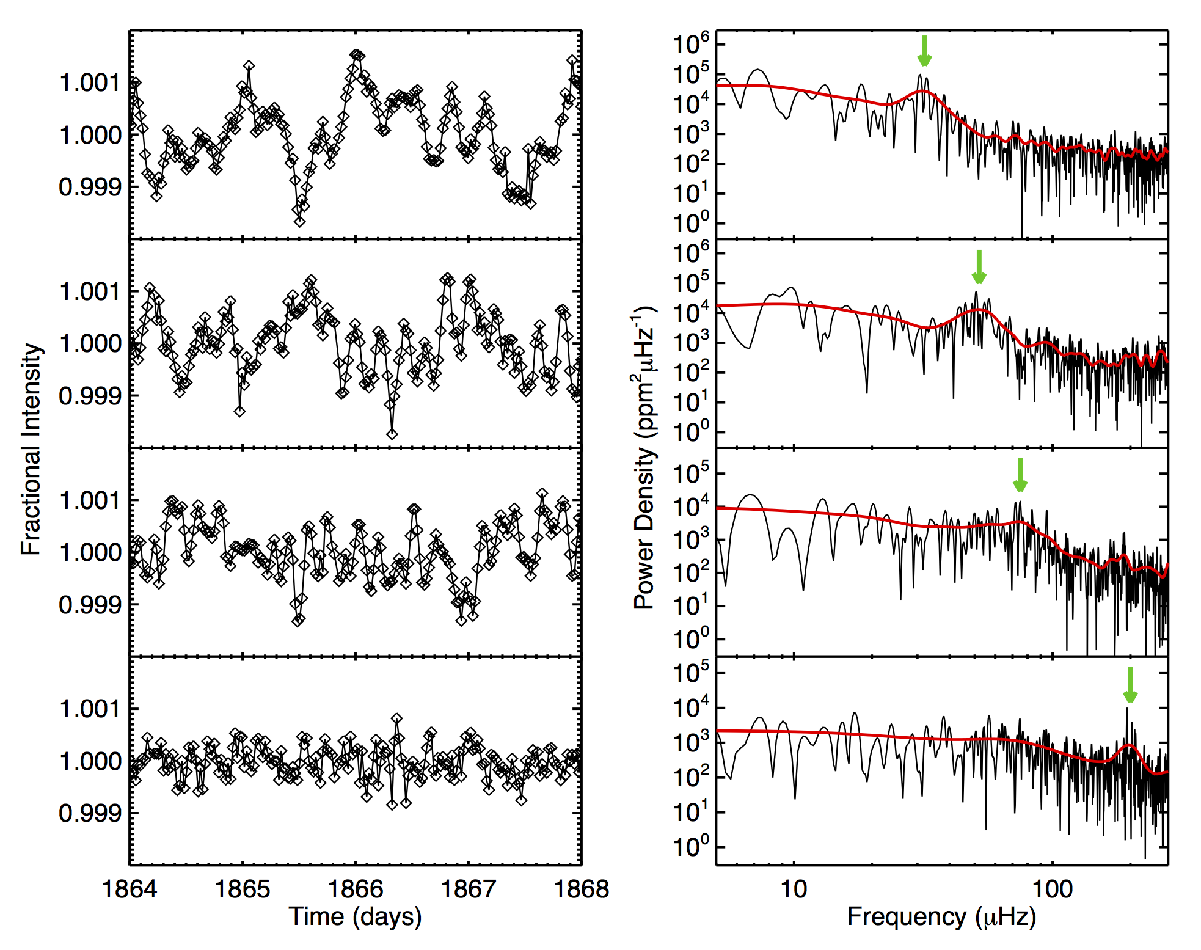
Asteroseismology Yields
Stellar Properties of Giant Stars
More Evolved
Less Evolved
K2 Senior Review Orals – 1 April 2014
53
OVERVIEW
PROGRESS & SCIENCE IMPLICATIONS
STATUS & COMMUNITY INVOLVEMENT
SPACECRAFT HEALTH
CONCLUSION
Notes:
<number>

Slide 21
K2 Key Science Cases
Extragalactic Observations
  AGN Variability
    Study accretion disk behavior and energy reprocessing
  SN light curves - progenitors
    Time 0+ light curves serendipitously observed
    Study shock break-out, model physics
Olling et al., 2014
<number>

Slide 22
K2 Key Science Cases
Microlensing
    K2 could perform the first microlens parallax measurement
    Many imaged lens events possible
Light curves at Earth and K2
Gould and Horne, 2013
<number>

Slide 23
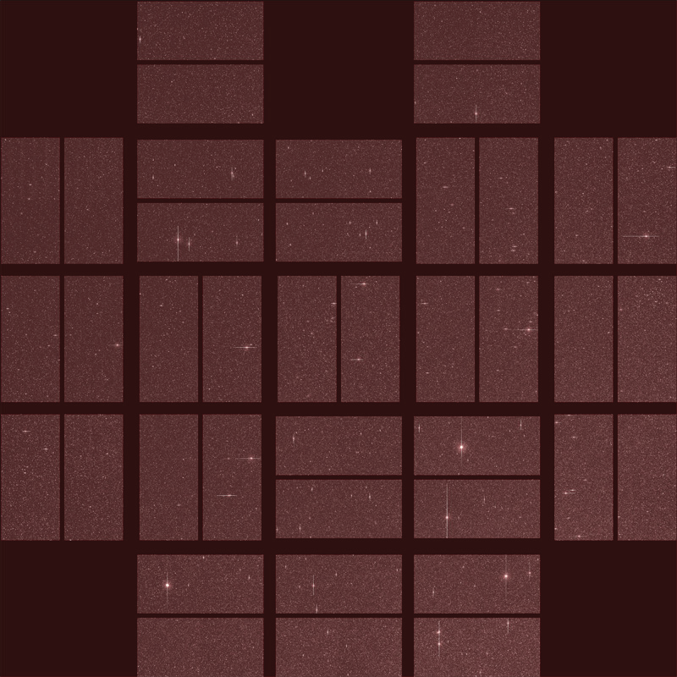
K2: First Light Image
Current Status
Scorpius Imaged by K2
December 2013
Campaign 0 – March-May 2014,
Calibrated pixel data public
Campaign 1 – June-Aug 2014
First science campaign, data in hand –
cal pixel data public in 75 days
Campaign 2 started 22 Aug 2014
<number>

